Slide 1
Nov 2015
Sum 2015
Specimen Paper 2016

Slide 2
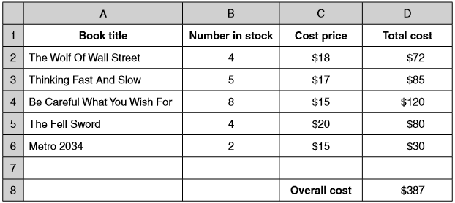
2015 Nov 12
A video shop owner uses a spreadsheet to calculate his costs. This is part of the spreadsheet.
Give the cell reference of the cell that contains $20. C5
Give the number of rows shown in the spreadsheet. 8
Write down the formula which should go in cell D2. =b2*c2
Write down the formula which should go in cell D8. Make the most efficient use of a function.
=sum(d2:d6)

Slide 3
2015 Nov 13
A student types in the formula =IF(A1>12,"strong",IF(A1>6,"medium","weak")) into a spreadsheet.
Explain, using the terms ‘condition’, ‘true’, ‘false’, how this nested IF function works.
Tests to see whether the condition A1>12 is true or false
If the condition A1>12 is true the function will return “strong”
If the condition A1>12 is false, the function will test if A1>6 is true or false
If the condition A1>6 is true the function will return “medium”
If the condition A1>6 is false the function will return “weak”
Another student wishes to reverse the formula to get the same result. She types in the formula IF(A1<6,"weak",IF(A1<12,"medium","strong)
Identify four errors she has made.
Should be A1<=6
Should be A1<=12
Should be “strong” (second speech mark missing)
Should be two right-hand brackets
Correct Formula
IF(A1<=6,"weak",IF(A1<=12,"medium","strong"))

Slide 4
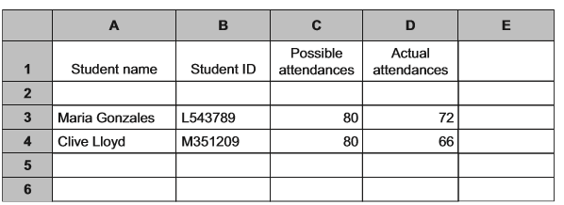
2015 Sum 11
A head teacher wants to store details of his students’ attendances in a spreadsheet. He has typed in the details of two students so far. Each student is identified by a student ID which consists of one letter followed by 6 digits. The number of possible attendances is recorded along with each student’s actual number of attendances.
The head teacher wants to ensure the Student ID is accurately entered. Describe a method of verifying the input.
Visually comparing the data on screen…with the source document
Data is typed in twice by one typist… Computer compares versions
He wants the spreadsheet to perform a calculation of the percentage attendance of Maria Gonzales in E3.
Explain how he would use the spreadsheet to do this
Type in =d3/c3 [1] *100 or
Type in =d3/c3 in e3 [1] Set the format to %

Slide 5
2015 Sum 11
He now wants to add another 18 students to the spreadsheet.
Explain how he could calculate the percentage attendance for each student by only using a computer mouse.
Click on E3
Manoeuvre to bottom right hand corner of cell Until black cross appears
Black cross dragged down to E22 (Autofill)
Give two reasons, apart from cost, why computer models are often used instead of the real thing.
Less dangerous to use a model
it may take a long time to obtain results from the real thing
Real thing may be wasteful of materials
Real thing may be on too vast a scale
Easier to change data/variables
The real thing may be impossible to access/create
You can test predictions more easily/model and can make predictions more accurately
You can ask many whatif questions which would be impractical in real life

Slide 6
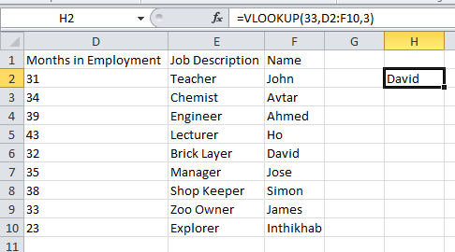
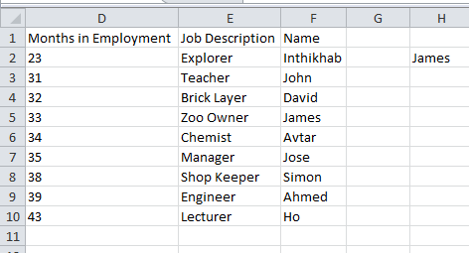
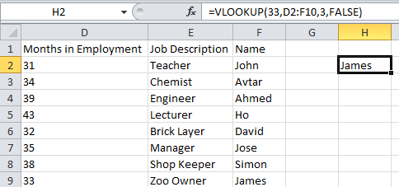
2015 Sum 12
Explain how a VLOOKUP function works, using the example of VLOOKUP(38,A2:C10,3,FALSE).
Searches for the value 38 (lookup Value)
Searches in the range A2:C10 (Table Array)
It returns the value that is contained in the third column of the range...
…and on the same row as the lookup value if it’s an exact match of 38
A spreadsheet contains the following data and formula. Explain why the cell H2 might not contain James. Suggest the value that would be contained in that cell, giving reasons why.
There is no return value/FALSE/0… …to force an exact match
The data is not sorted on column D.
So only an approximate match will be made .
So formula will return David
Numbers sorted
False – Exact Match

Slide 7
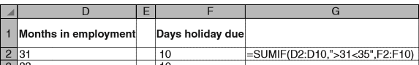
2015 Sum 13
Explain how a SUMIF function works, using the example of SUMIF(A1:A6, “>29”, B1:B6).
This formula searches for values in the range: A1:A6…
…which match the criterion >29
It totals the value in the corresponding cells of the SUM range B1:B6.
A spreadsheet contains the following data and formula
Explain why the cell G2 does not produce the expected value of 30.
>31<35 is not a valid logical test
Write down a formula which would total the Days holiday due to those workers who had worked for the company for more than 31 months but less than 35 months.
=SUMIF(D2:D10,“>31”,F2:F10) – (minus sign) SUMIF(D2:D10,“>=35”,F2:F10)

Slide 8
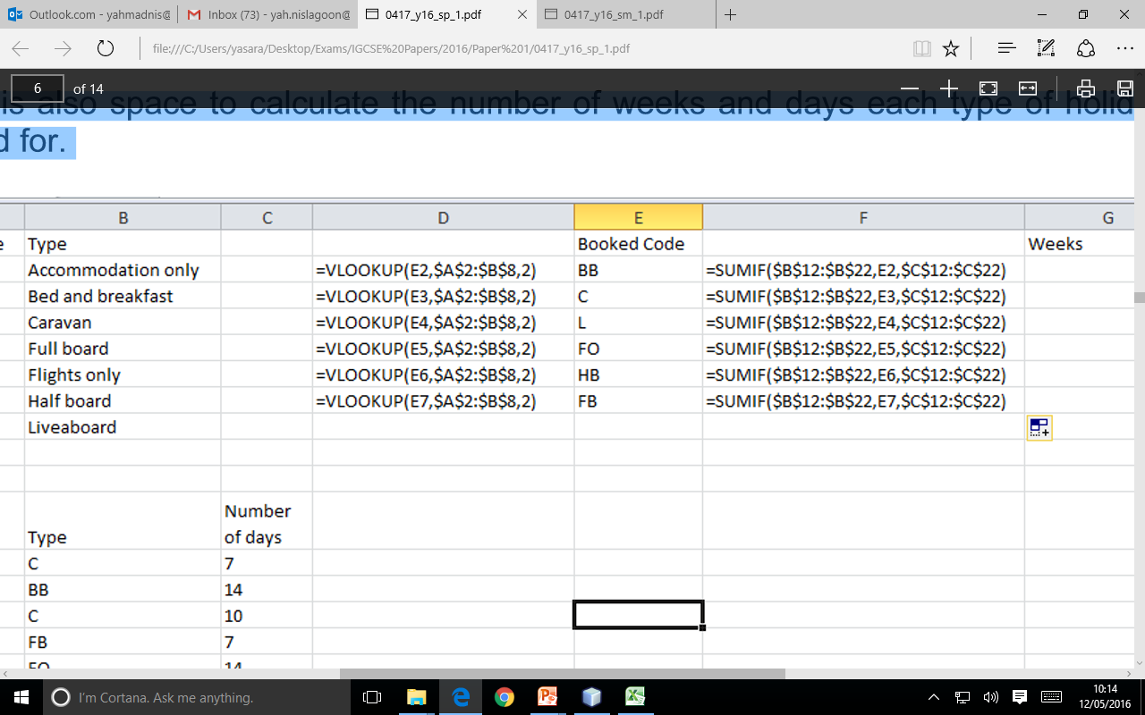
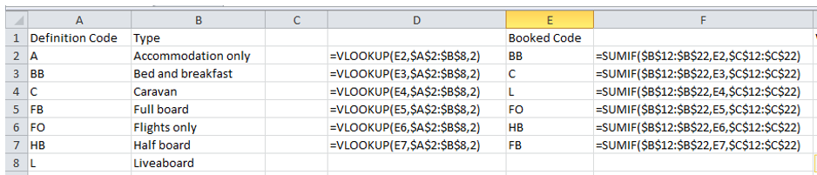
2016 Specimen
A holiday company uses spreadsheets to organise the holidays they offer for scuba divers. In the first two columns, there is a list of holiday codes together with the accommodation offered.
Table Array
Column index
Lookup Value
Explain what the formula in cell D2 does
Reads the contents of E2/BB (Lookup Value)
Compares with the contents of A2:B8 (Table Array)
until it finds the first matching value from the column index (2)
It records the corresponding value from column 2 of the range A2:B8
E2 contains BB – produces /records Bed and breakfast
What type of holiday would you expect to see in D5? Flights only
.

Slide 9
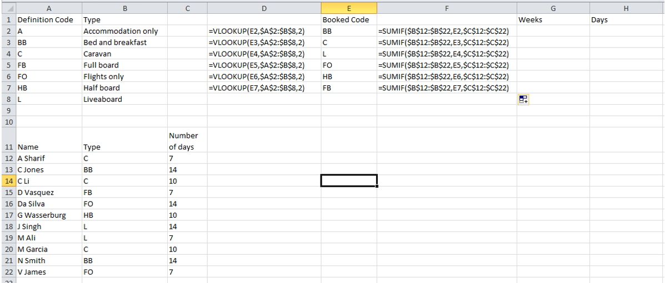
2016 Specimen
Also in the spreadsheet, there are formulae to manipulate the data stored elsewhere in the spreadsheet.
There is also space to calculate the number of weeks and days each type of holiday has been booked for.
Criteria
Range
Sum Range
Explain what the formula in cell F2 does.
It looks through the cells B12 to B22 (Range)
It adds the contents of C12 to C22 (SumRange) where…
The corresponding value of B12 to B22 is equal to E2 (Criteria)
The value in F2 will be 28.
.

Slide 10
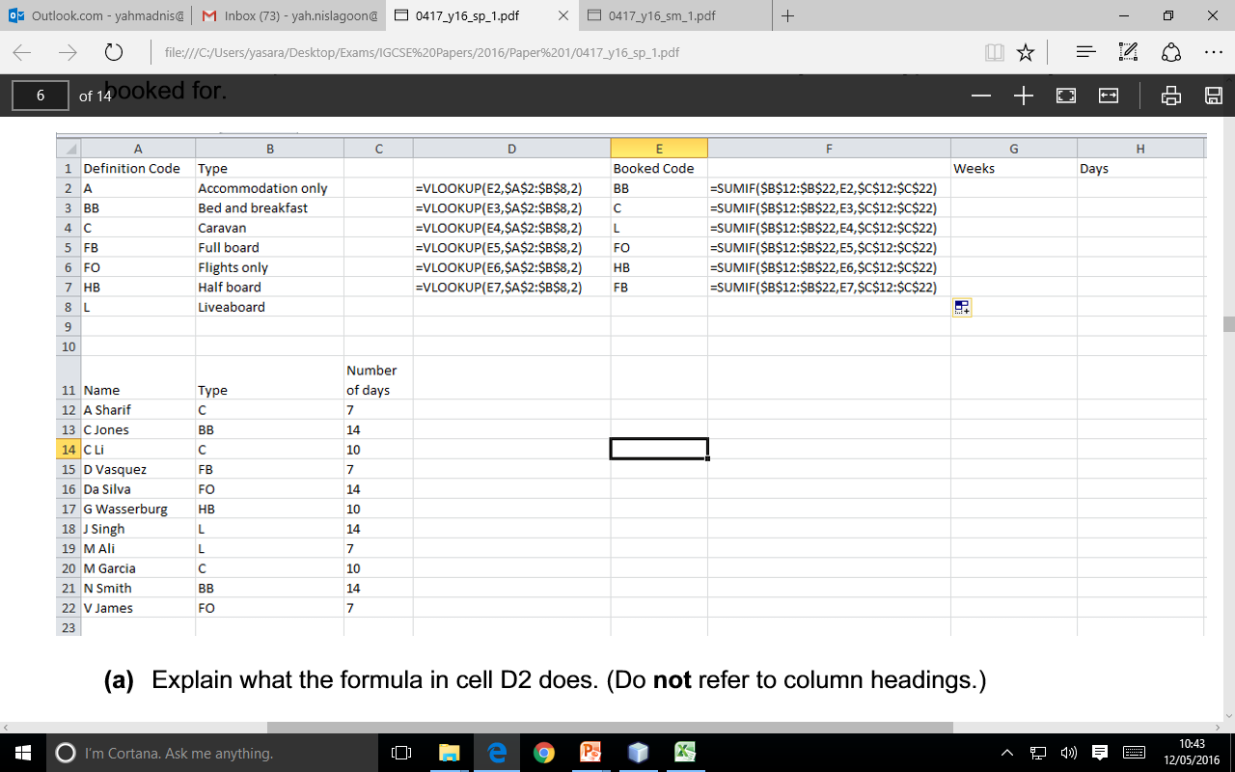
2016 Specimen
Criteria
Range
Sum Range
What value would you expect to see in F5? 21
.

Slide 11
2016 Specimen
The SUMIF will work out the total number of days
What formula would you expect to see in G2? = INT(F2/7)
This formula will divide the days by 7.
INT will round down the number to its nearest Interger Value.
.

Slide 12
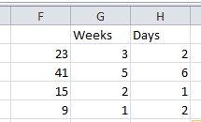
2016 Specimen
What formula would you expect to see in H2? =(G2*7)-F2
This formula will work out the number of days.
For example in F2 if the value is 15 then the number of weeks will be 2 and the days will be 1.
Total Number of Days
To work out the days you first have multiply the weeks by 7
Then you have to subtract the total number of days (F2) from the first part of the formula.
-
.

